Slide 1
Protecting against PHI Breaches using Streaming and NLP

Slide 2
Me :)
Jeff Zemerick
Consultant @ Mountain Fog, Inc.
Pittsburgh, PA
@mtnfog
jeff.zemerick@mtnfog.com | www.mtnfog.com
https://www.linkedin.com/in/jeffzemerick/
ASF Member
Apache OpenNLP Committer / PMC
Notes:
Mountain Fog has clients in healthcare, government, and cloud.
Provide consulting services around cloud, big-data, and NLP.
Managing PHI in text crosses all three of those.

Slide 3
Introduction
The days of offline batch processing are so 2000s.
Streaming gives new risks, challenges, and opportunities for managing PHI.
How to manage natural language text with PHI for:
Compliance and security
To make the data usable for secondary purposes
Notes:
We have a better opportunity to process data as it comes in instead of doing it later.
We can also do it without heavy modifications to existing deployed code.
But it comes with its own set of challenges.

Slide 4
Protected Health Information
PHI / ePHI

Slide 5
What is PHI?
Protected Health Information
Any health information that can be traced to a specific individual.
HIPAA broadly defines 18 identifiers, some are:
Names, Geographic identifiers meeting certain criteria, Dates
Phone numbers, Email addresses, Biometric
https://www.hhs.gov/hipaa/for-professionals/index.html
Notes:
We’ve heard of it but what is it?

Slide 6
What Regulates PHI?
Health Insurance Portability and Accountability Act of 1996 (HIPAA)
1) HIPAA Privacy Rule
Defines protections for PHI by health plans, clearinghouses, and providers.
2) HIPAA Security Rule
Defines protections for PHI through confidentiality, integrity, and availability.
Source: https://www.hhs.gov/hipaa/for-professionals/index.html
Notes:
Why is PHI important? What are the governing regulations?

Slide 7
What Regulates PHI?
Health Insurance Portability and Accountability Act of 1996 (HIPAA)
3) HIPAA Enforcement Rule
Defines provisions relating to compliance and investigations.
4) Final Omnibus Rule
Implements provisions of the HITECH ACT to strengthen privacy and security protections under HIPAA.
Source: https://www.hhs.gov/hipaa/for-professionals/index.html

Slide 8
HIPAA Terminology
Covered entity - Health plans, clearinghouses, providers.
Business associate - someone working on behalf of a covered entity that requires access to PHI.
A business associate agreement (BAA) defines each party’s responsibilities. https://www.hhs.gov/hipaa/for-professionals/covered-entities/sample-business-associate-agreement-provisions/index.html
Notes:
The contract must describe permitted and required PHI uses for the business associate, and also state that the business associate “will not use or further disclose the protected health information other than as permitted or required by the contract or as required by law.”
Appropriate safeguards need to be established, ensuring that the business associate will prevent PHI disclosure outside of what is permitted in the contract.
(1) establish the permitted and required uses and disclosures of protected health information by the business associate;
(2) provide that the business associate will not use or further disclose the information other than as permitted or required by the contract or as required by law;
(3) require the business associate to implement appropriate safeguards to prevent unauthorized use or disclosure of the information, including implementing requirements of the HIPAA Security Rule with regard to electronic protected health information;
(4) require the business associate to report to the covered entity any use or disclosure of the information not provided for by its contract, including incidents that constitute breaches of unsecured protected health information;
(5) require the business associate to disclose protected health information as specified in its contract to satisfy a covered entity’s obligation with respect to individuals' requests for copies of their protected health information, as well as make available protected health information for amendments (and incorporate any amendments, if required) and accountings;
(6) to the extent the business associate is to carry out a covered entity’s obligation under the Privacy Rule, require the business associate to comply with the requirements applicable to the obligation;
(7) require the business associate to make available to HHS its internal practices, books, and records relating to the use and disclosure of protected health information received from, or created or received by the business associate on behalf of, the covered entity for purposes of HHS determining the covered entity’s compliance with the HIPAA Privacy Rule;
(8) at termination of the contract, if feasible, require the business associate to return or destroy all protected health information received from, or created or received by the business associate on behalf of, the covered entity;
(9) require the business associate to ensure that any subcontractors it may engage on its behalf that will have access to protected health information agree to the same restrictions and conditions that apply to the business associate with respect to such information; and
(10) authorize termination of the contract by the covered entity if the business associate violates a material term of the contract.

Slide 9
Penalties for Noncompliance
Per HHS Office for Civil Rights (OCR):
213,561 HIPAA complaints since April 2003.
OCR has settled or imposed civil money penalties in 65 cases totaling $102,681,582.
2018 was a record year with $28.7 million in fines.
Sources:
https://www.hhs.gov/hipaa/for-professionals/compliance-enforcement/data/enforcement-highlights/index.html
https://www.hhs.gov/about/news/2019/02/07/ocr-concludes-all-time-record-year-for-hipaa-enforcement-with-3-million-cottage-health-settlement.html
Notes:
Not only was 2018 a record year but there has been an upward trend in fines in the past few years.

Slide 10
Managing PHI
Know your application boundaries.
Clearly define the boundaries upfront.
If in the cloud don’t use a service not on the cloud’s BAA.
https://aws.amazon.com/compliance/hipaa-eligible-services-reference/
Keep PHI separate.
Separate components that process PHI.
Knowledge of HIPAA should be prevalent.
Even more important for DevOps teams.
Encryption at rest and in motion.
Least privileges.
Notes:
Cloud services on BAAs change often. Services typically get added over time.
Best to define your software architecture around PHI and define its boundaries from the beginning.
Can take the “all in” approach and say it is all PHI but that can drastically increase time and cost.

Slide 11
Secondary Purposes
Health data without PHI has uses:
Studies into trends and predictions
Advertising and marketing
Research and development
Realistic test data in non-production environments
Machine learning stuff!
Crosses many industries.
Notes:
In addition to security protection, there are secondary purposes, too.
Relevant in many industries: Healthcare, R&D, Insurance

Slide 12
Data De-identification
Data has been stripped of the 18 identifiers.
Referred to as the “Safe Harbor Method”
An experienced statistician validates the risk of re-identification is “very small.”
Referred to as the “Statistical Method”
Contains a link to the original data set.
May be re-linked by a trusted party in the future.
Notes:
Sometimes hear “Anonymization” used but is actually a different process.
Unidentified (i.e., personally identifiable information was not collected, or if collected, identifiers were not retained and cannot be retrieved)
Information or materials (e.g., data or specimens) that cannot be linked directly or indirectly by anyone to their source(s).

Slide 13
Identifying PHI

Slide 14
Methods of Finding PHI
Regular expressions
Dictionary lookups
NLP-based methods
Combinations of these methods (and maybe others) (Usually) best to be safe!
False positives are more acceptable (maximize recall).
Notes:
Balancing risk is difficult.
Too sensitive and the text may lose important meaning.
Not enough risks PHI.

Slide 15
Regular Expressions
Some PHI is identifiable through patterns.
But be careful -- there can be variations.
123-45-67890 or 1234567890
800-123-4567 or (800) 123-4567
SSN | ^\d{3}-\d{2}-\d{4}$
Phone Number | ^[2-9]\d{2}-\d{3}-\d{4}$
Notes:
Being familiar with your data can help. If a specific SSN pattern is always used then you can be more certain.

Slide 16
Dictionaries
Some PHI can be found in dictionaries.
Geographic subdivisions smaller than a state
Zip codes (based on population)
Use a search engine to index the dictionaries.
Fuzzy search capabilities.
String distance functions can help find misspellings: “New Yrk” => “New York”
Notes:
US census has great information on locations and populations.
Essentially a spelling correction functionality.

Slide 17
NLP Named Entity Recognition
PHI that cannot be indexed or follow a pattern.
John Smith was diagnosed with asthma.
[John Smith] was diagnosed with [asthma].
Person
Diagnosis
Notes:
Some things can be indexed. Diagnoses can be indexed.
Can build a dictionary of common names.
So sometimes a combination of methods is beneficial.

Slide 18
Neural Network Classifier
Named-entity recognition.
Good news! A lot of examples and frameworks to build on.
Requires annotated text to train the model.
Bad news! Often the biggest challenge.
Notes:
NLP neural networks have got really good at doing NER.

Slide 19
Using Word Embeddings
Word embeddings capture context of words.
Started by word2vec in 2013.
Can also handle out-of-vocabulary (OOV) words by operating on subwords, e.g BERT, ELMo, FastText.
Can fine tune pre-trained model if you have your own dataset.
Use BERT’s pre-trained models trained from Wikipedia.
Fine-tune the pre-trained model on your corpus (unsupervised).
Notes:
OOV is important because healthcare’s vocabulary is large and varies greatly between patients.

Slide 20
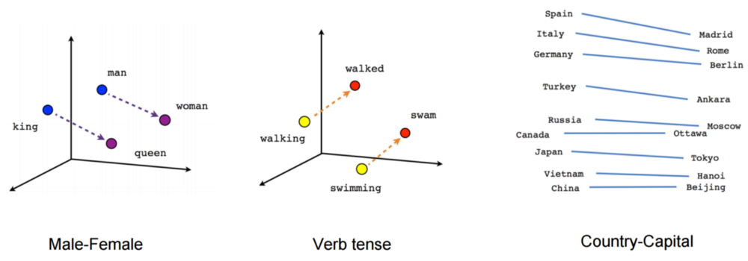
Word Embeddings
Source: https://www.tensorflow.org/tutorials/representation/word2vec

Slide 21
Breaking Text into Subwords
"positional addition contextual"
Notes:
Byte-pair encoding example

Slide 22
Breaking Text into Subwords
"posiXonal addiXon contextual"
X=ti
{
Subwords

Slide 23
Breaking Text into Subwords
"posiXonY addiXon contextuY"
X=ti
Y=al
{
Subwords

Slide 24
Breaking Text into Subwords
"posiZnY addiZn contextuY"
X=ti
Y=al
Z=Xo
{
Subwords

Slide 25
Breaking Text into Subwords
"posiZnY addiZn contextuY"
X=ti
Y=al
Z=Xo
{
Can now recognize new words as combinations of previously seen subwords.
Subwords

Slide 26
Combinations of Methods
Dictionary of US zip codes.
US zip codes do change (even if not often).
Can also have a regex ^\d{5}(-\d{4})?$
Dictionary of street addresses.
Dictionary may not be complete, streets could change.
Train entity model to identify street names.
Maybe even a regex?

Slide 27
Streaming Architecture

Slide 28
Streaming Architecture
Streamed Data
Notes:
We can now process streaming data to remove PHI as it comes in instead of having to process the data later.
We often don’t know where the downstream data is going and how it will be used at the time of ingestion.

Slide 29
Streaming Architecture
Covered Entity
Business Associate

Slide 30
Streaming Architecture
The goal: No significant pipeline changes.

Slide 31
Stream Processing
Apache Flink stream processing framework.
High-throughput, low-latency streaming engine.
Fault tolerant.
Supports exactly-once semantics.
Runs on YARN, Mesos, Kubernetes, AWS EMR, and clustered deployments.
Can use Flink to identify PHI in streams.
Notes:
Flink has high-throughput, low-latency and is fault tolerant.
We can be guaranteed that each message is processed exactly once.
Runs in a lot of places.

Slide 32
Apache Flink
Notes:
In short, Flink can consume from lots of data sources, process that data, and send it somewhere else.

Slide 33
Flink Consuming from Kafka
Apache Kafka Connector allows for reading and writing from/to Kafka topics.
1. Consume
2. Process
3. Publish

Slide 34
The Flink Job
Contains our PHI identification and/or removal logic.
Stateless - text comes in, is processed, and text goes out.
Sits in the existing pipeline.
public class RemovePhiFunction implements MapFunction<String, String> {
@Override
public String map(String text) throws Exception {
// Analyze the text for PHI. // TODO: Implement :)
} }

Slide 35
Streaming Architecture
Only change is the name of the topic to consume from.
Notes:
We can now have two topics:
1 contains the original text.
2 contains the filtered text.

Slide 36
Another Way: Apache NiFi

Slide 37
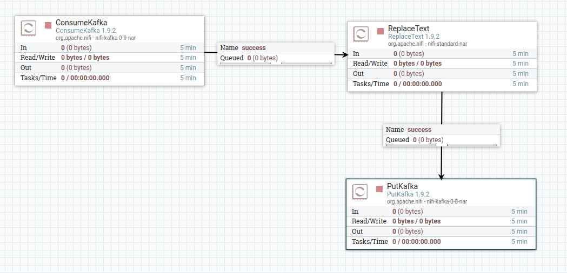
Using Apache NiFi
ReplaceText processor finds regex matches and replaces them.
Notes:
A custom processor can handle other methods.
The code used in the Flink job can be re-used in a custom NiFi processor.

Slide 38
Summary
Extremely important PHI be treated with care.
De-identification can make data usable for valuable secondary purposes.
PHI can be identified through various methods.
Those methods can be implemented as a streaming job.
Text can be processed as it streams with minimal changes to the pipeline.

Slide 39
Thank you!

